Slide 1
ML4MI Bootcamp: Data preparation and network architecture
Updated:
July 20, 2018
Contributors:
Tyler J Bradshaw ( tbradshaw@wisc.edu )

Slide 2
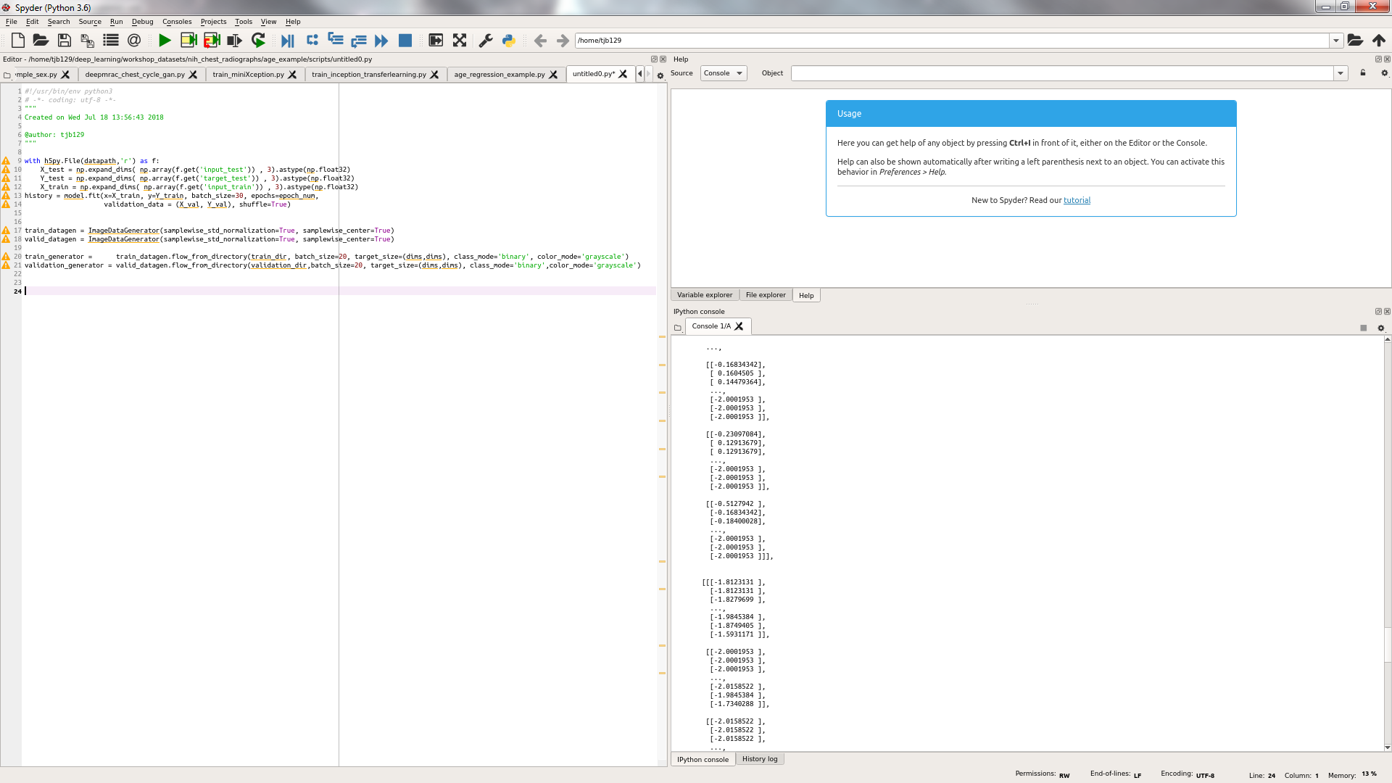
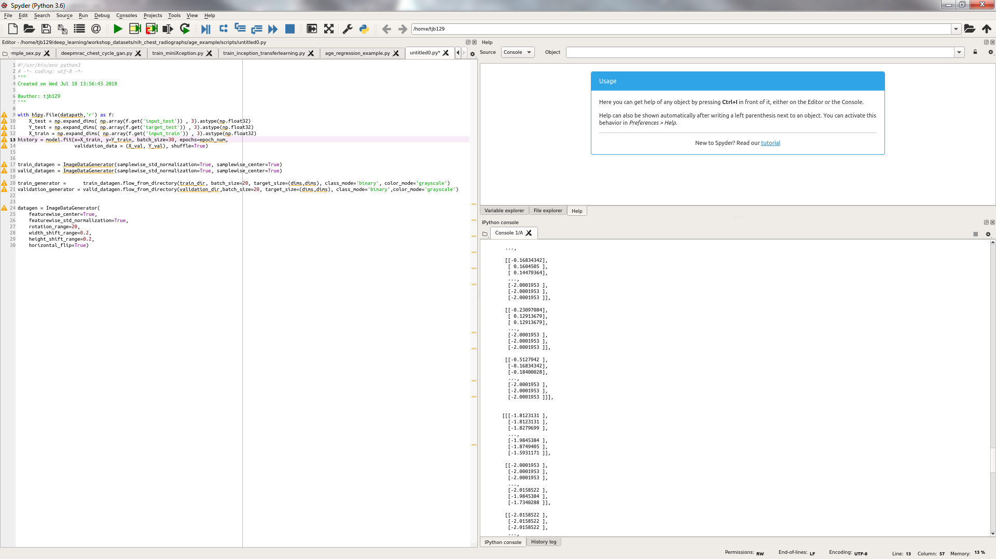
Data preparation
Most packages require data in numpy array
How to get data into numpy array for Keras?
ImageDataGenerator : flow_from_directory
Great for classification problems, 2D images
Read from disk (not memory limited!)
Automates a lot of steps (one-hot encoding, image manipulation, input normalization)
Not very flexible (only for classification)
ImageDataGenerator : flow
Same benefits of flow_from_directory(), but is read into memory first
Numpy arrays using HDF5 (or pickle, or other data format)
Less automated
Most flexible

Slide 3
Data preparation – flow_from_directory directory structure
Image1.png Image2.png : :
Data/
Train/
MRI/
CT/
Test/
MRI/
Validate/
CT/
MRI/
CT/
Keras sees 2 folders under “Train”, so it assigns 2 classes
Image1.png Image2.png : :
Image1.png Image2.png : :
Image1.png Image2.png : :
Image1.png Image2.png : :
Image1.png Image2.png : :

Slide 4
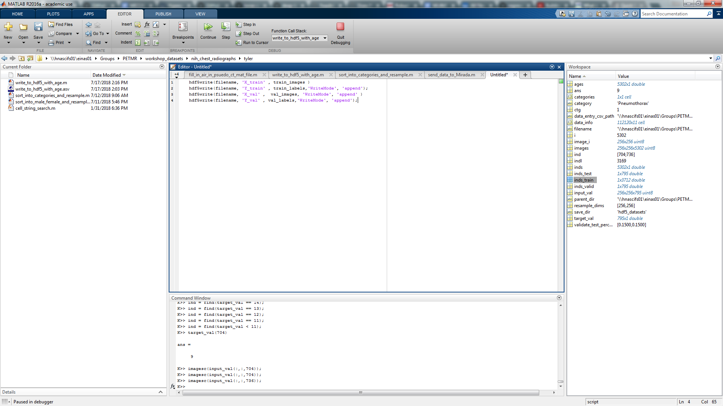
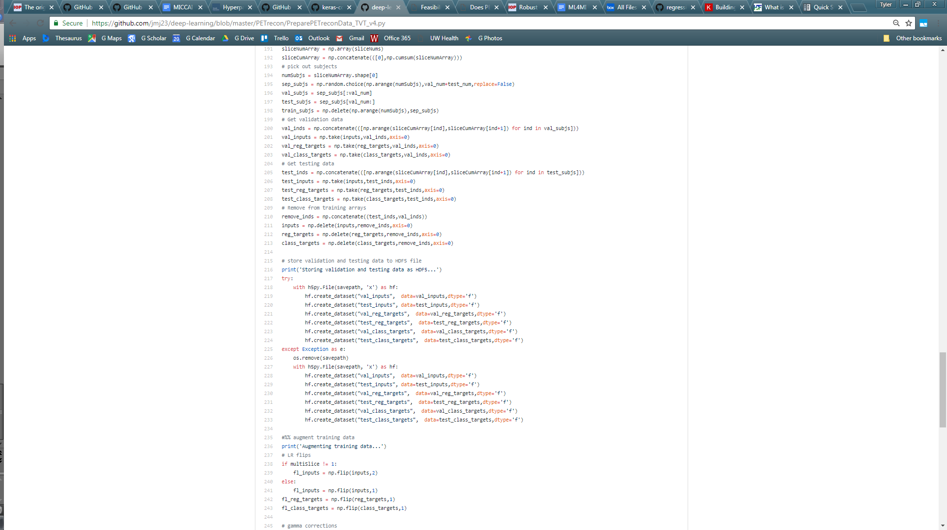
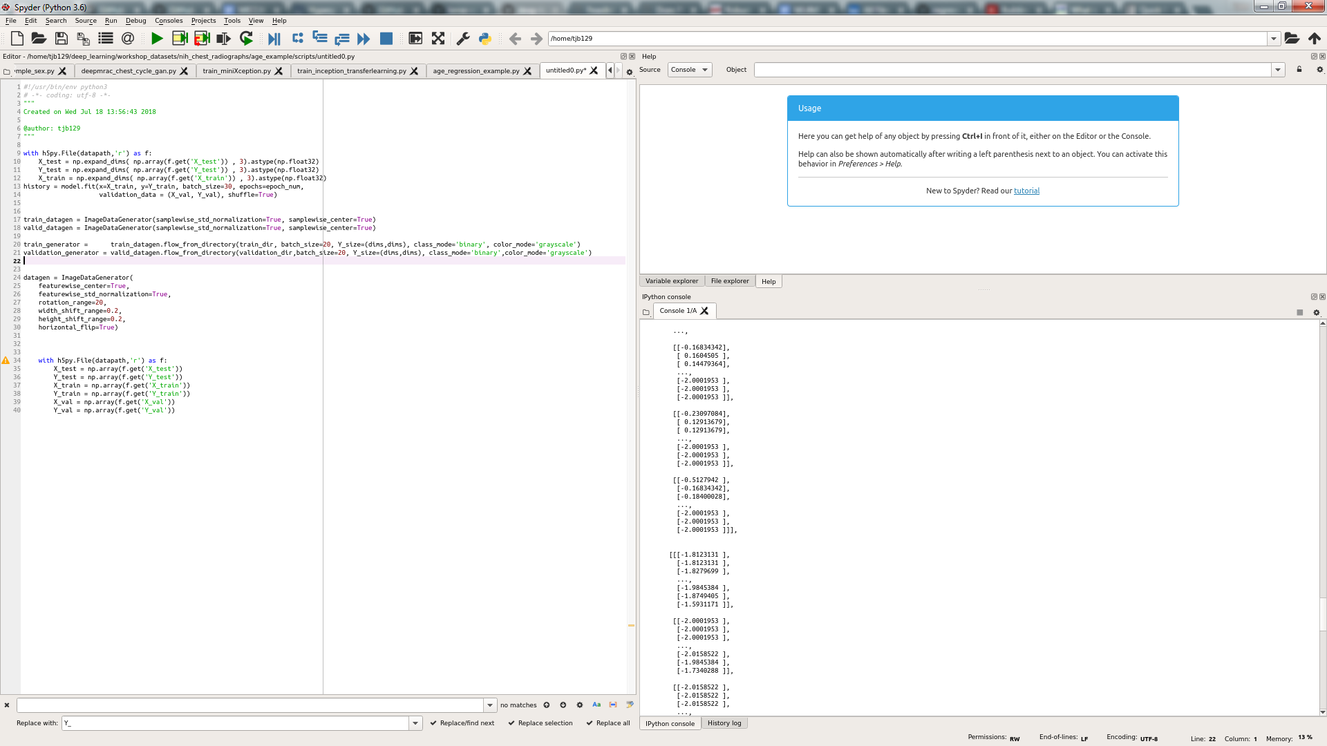
Data preparation – HDF5 to numpy
HFD5 (.hdf5 or .h5) is a very flexible data type
Can store many types of data in different formats, all in the same file
Think of .mat for Matlab
No size limit
Composed of “datasets” (or variables)
Creating HDF5 with Matlab*
Creating HDF5 with Python
Reading HDF5 with Python
* There is a way to write HDF5 iteratively if you can’t fit it all into memory

Slide 5
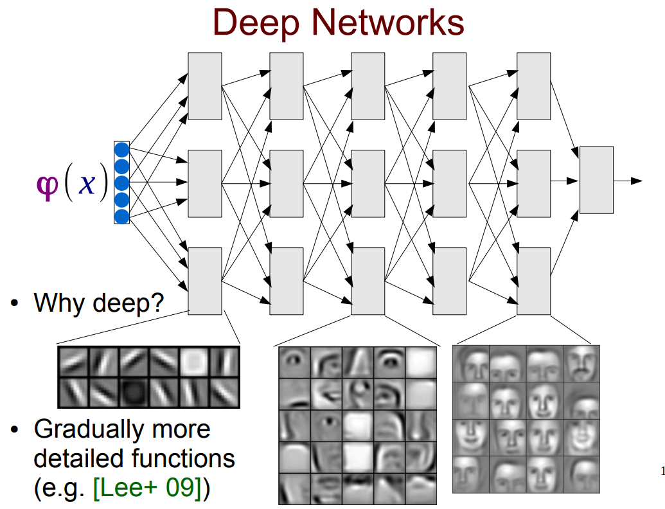
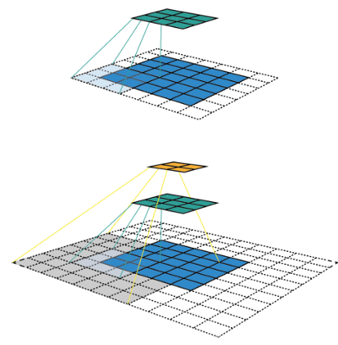
Network architectures
Receptive field
http://www.phontron.com/slides/neubig14deeplunch11.pdf
https://medium.com/syncedreview/a-guide-to-receptive-field-arithmetic-for-convolutional-neural-networks-42f33d4378e0

Slide 6


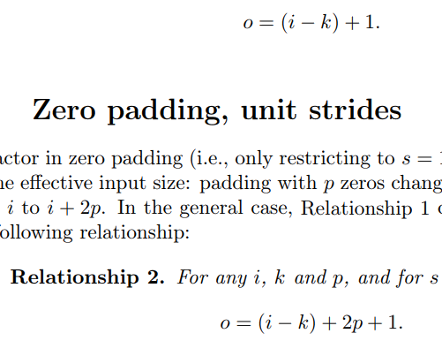

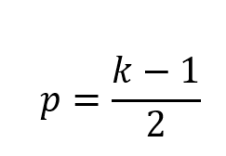
Network architectures – Convolution arithmetic
Without padding or strides, the input image (i) is reduced in dimensions by k-1, where k is the kernel size
With padding (p) and strides (s), the output (o) becomes
For output dimensions (o) to equal input dimensions (i) Accomplished in Keras with: Conv2D(…, padding=‘same’)
Dimensions reduced
Dimensions preserved
No stride, no padding
No stride, with padding
Dimensions reduced
With stride, with padding
https://arxiv.org/abs/1603.07285

Slide 7
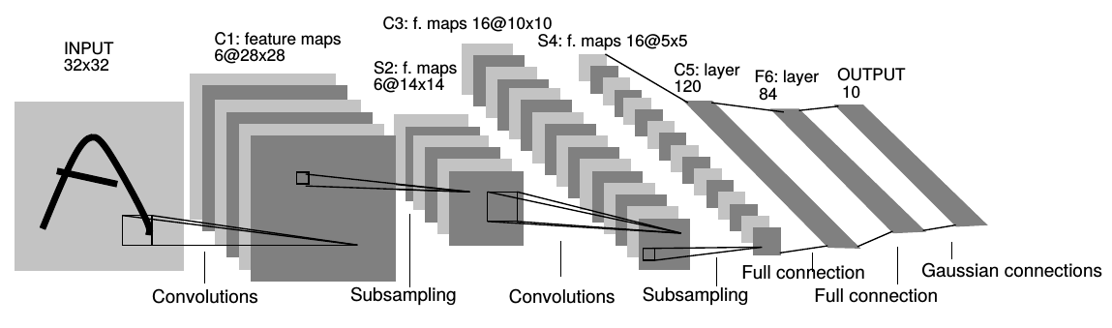
Network architectures – LeNet (LeCun 1998)
Recognized as the first CNN
The following slides are important network architectures to know

Slide 8
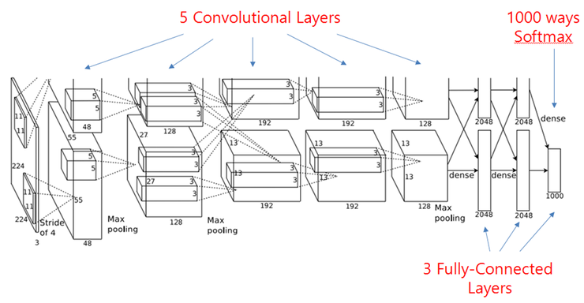
Network architectures – AlexNet (Krizhevsky, Hinton, 2012)
Jumpstarted the deep learning gold rush
Run on 2 GPUs (hence the top-bottom split)
Used ReLU, dropout, data augmentation, and batch training
http://rajatvikramsingh.github.io/media/DeepLearning_ImageNetWinners.pdf

Slide 9

Network architectures – VGG16 (Simonyan, 2014)
Didn’t win ImageNet, but became popular due to simplicity
2 layers of 3x3 convolutions more efficient than one 5x5 layer, yet have same receptive field
http://rajatvikramsingh.github.io/media/DeepLearning_ImageNetWinners.pdf

Slide 10
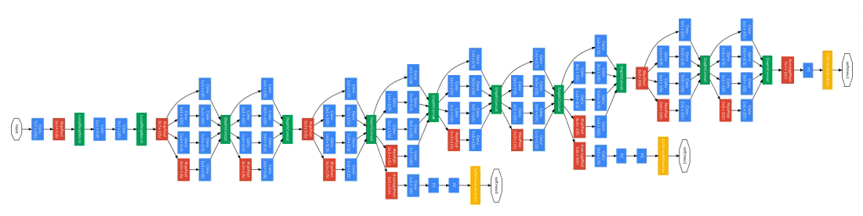
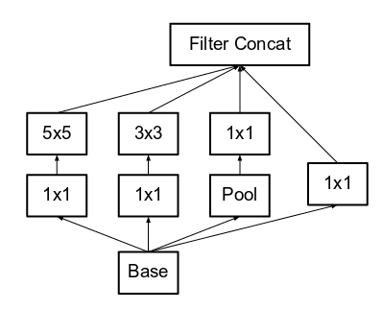
Network architectures – GoogLeNet / Inception (Szegedy, 2014)
Non-sequential (inception blocks)
Considered very deep/large at the time
Now on Inception V4
http://rajatvikramsingh.github.io/media/DeepLearning_ImageNetWinners.pdf

Slide 11
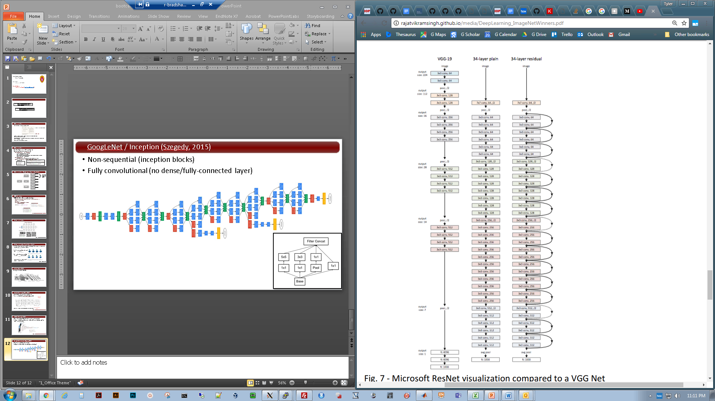
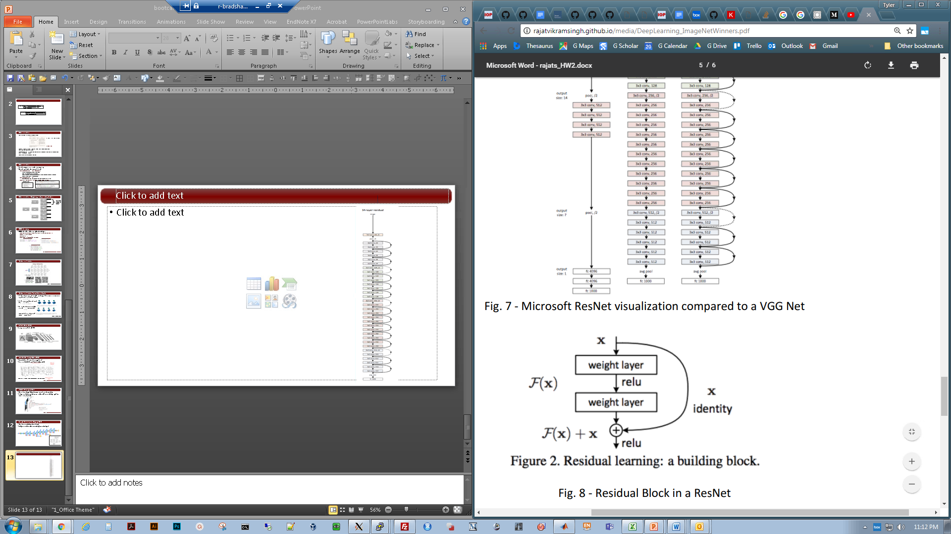
Network architectures – ResNet (Microsoft, 2015)
Residual blocks allow deeper training (152 layers)
http://rajatvikramsingh.github.io/media/DeepLearning_ImageNetWinners.pdf

Slide 12

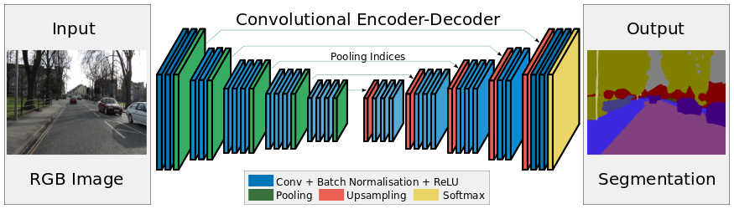
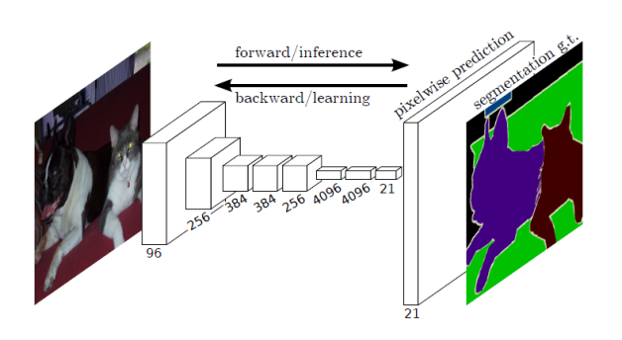
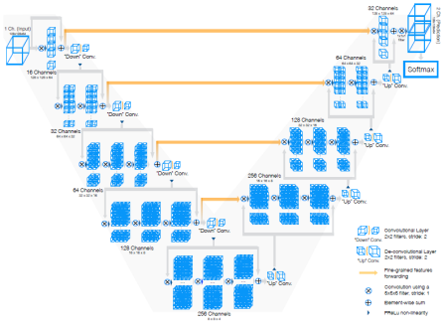
Network architectures – U-net (Ronneberger, 2015)
Has set the standard for image segmentation
Fully convolutional (encoder-decoder)
Concatenates downsampled and upsampled activation maps
Many derivatives:
SegNet
FCN
V-Net

Slide 13
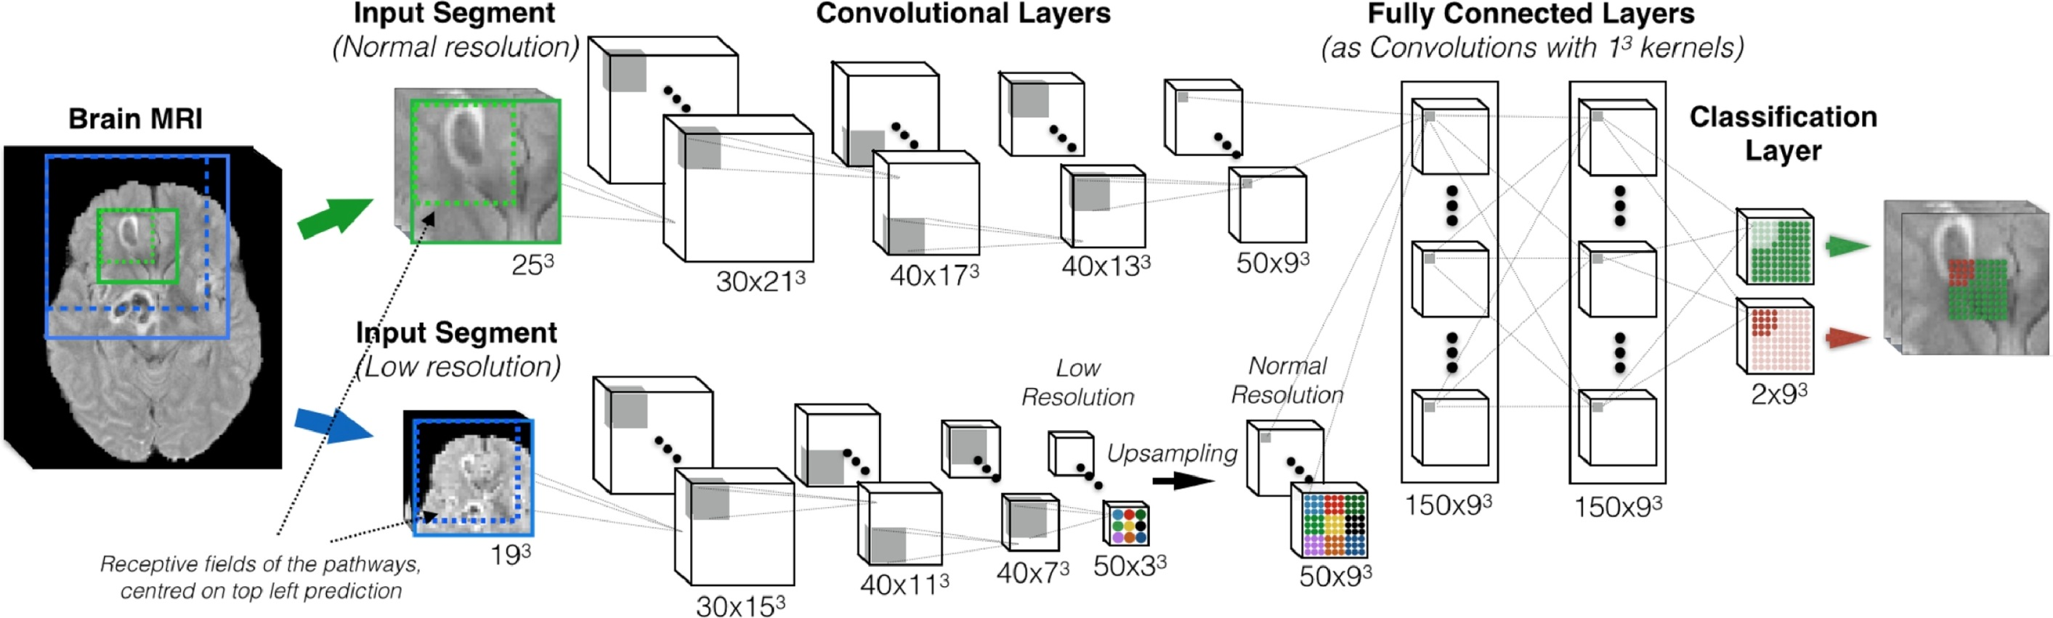
Network architectures – DeepMedic (Kamnitsas, 2017)
Dual pathway at 2 resolution levels
3D convolutional filters (5x5x5)
Efficient patch-based method

Slide 14




Network architectures – Last-layer activation functions
Problem type | Last-layer activation | Loss function
Binary classification | Sigmoid | binary_crossentropy
Multiclass, single-label classification | Softmax | categorical_crossentropy
Multiclass, multilabel classification | Sigmoid | binary_crossentropy
Regression (continuous output) | Linear | mse
Regression to values between 0 and 1 | Sigmoid | mse OR binary_crossentropy
Cat
Cat, Dog
Dog
Dog, Dinosaur
From Chollet, Deep Learning with Python

Slide 15
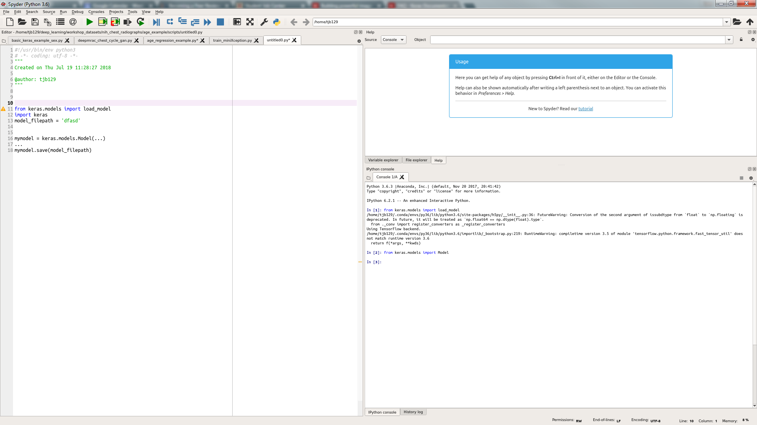
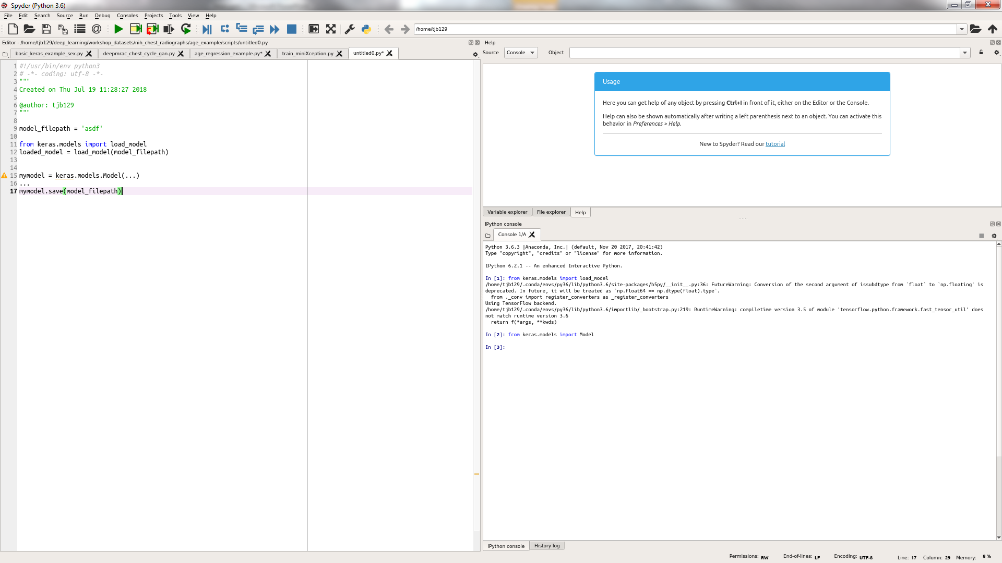
Saving/restoring models
Once a network is developed and trained, it can be saved and loaded
Saves model’s architecture, trained weights, training configuration (loss type, optimizer), and state of optimizer (so you can continue training)
To load a model
There are also ways to save/load just the model architecture or weights

Slide 16
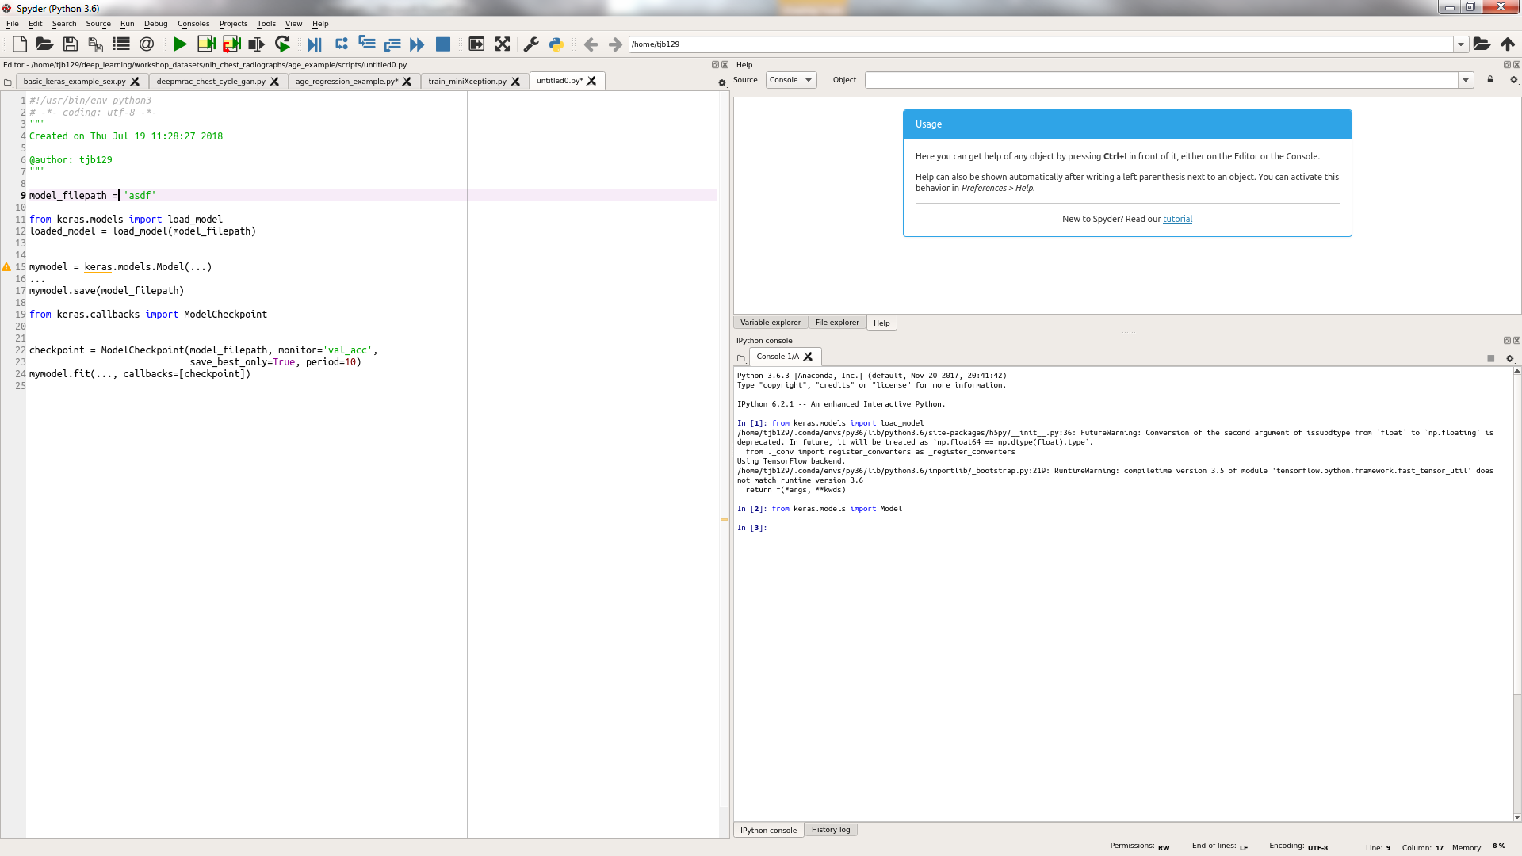

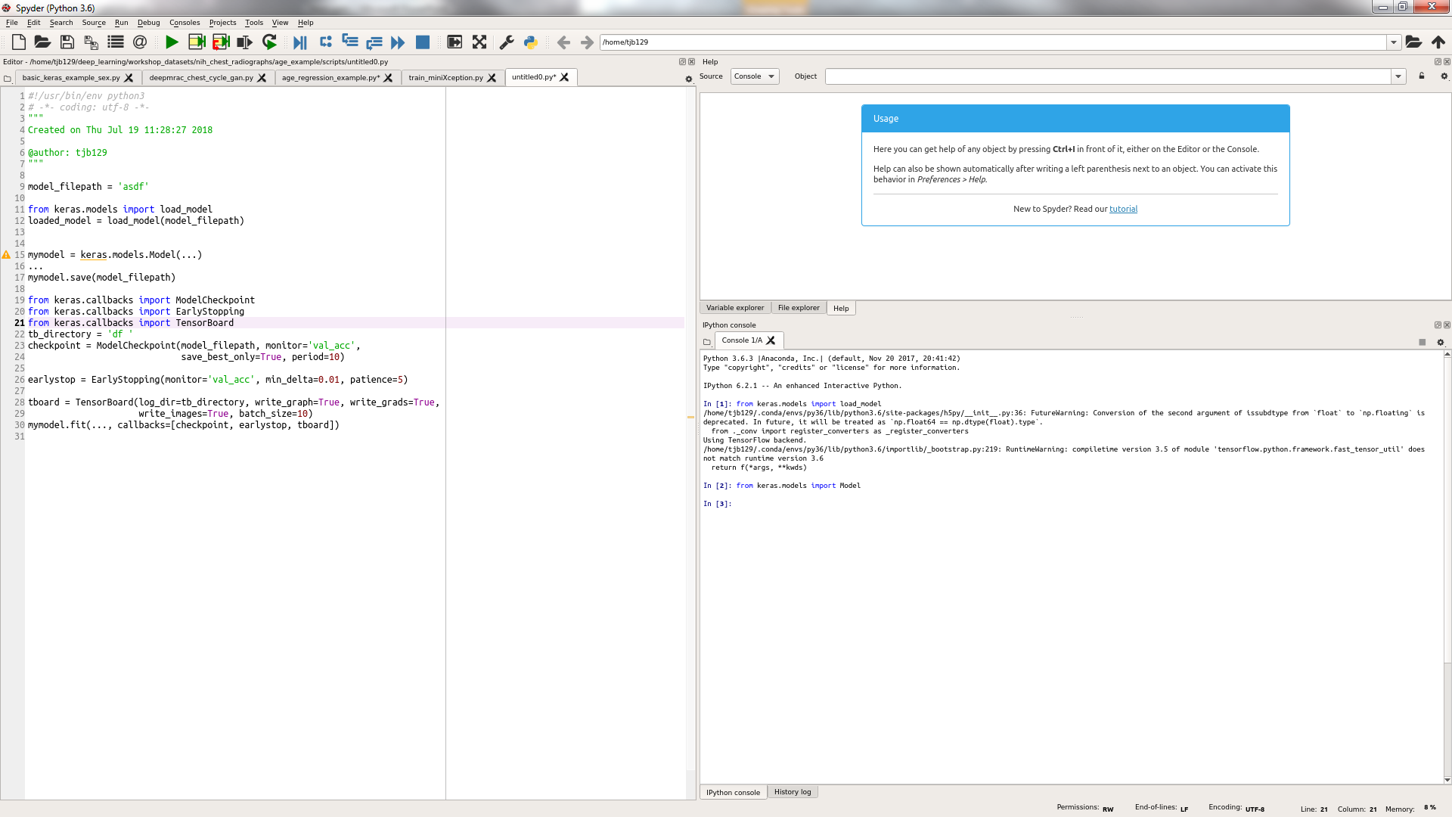
Saving/restoring models
Keras callback functions are applied during training, get passed to the model.fit( ) method
Useful callback functions
ModelCheckpoint( )
Can save model after every epoch (or any number of epochs)
Can save only the best model during training (checks validation score after each epoch)
EarlyStopping( )
Stop training after a criterion is met (eg, validation accuracy decreases for 10 epochs)
TensorBoard( )
A visualization tool for plotting train/val loss, making network graph, inspecting images/weights

